Slide 1
Carpool Slides

Slide 2
Grafana
Row 1 : Providing Offers
Each color is a provider, and the duration for which the offer is valid is indicated by the presence of the color during that interval.
Row 2 : Consuming Offers
Same as row 1 except they are consuming rather than providing offers.
Row 3 : Matched Production/Consumption Offers - Quantity
The actual matched offers for each interval, the height is the number of seats matched
Row 4 : Solve Time/Finalize time
Solve time : the time taken to find a solution given the set of offers
Finalized Time : The time between when the Event Recorder gets the FinalizeRequested and FinalizeComplete events from the blockchain.
Row 5 : Matched Production/Consumption Offers - Value
Same as row 3, except the height is the value of the trade.
https://snapshot.raintank.io/dashboard/snapshot/Mhdw29Tkl9Wp3wSNFYj8RQ6f6TyXUgiU
I was able to run with 80 carpoolers.

Slide 3
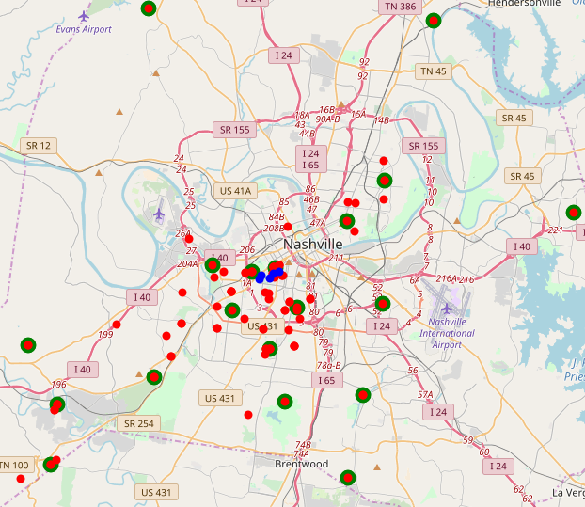
Map data
Red dots : artificial residences
Green dots : carpool locations
Blue dots : Destinations on Vanderbilt Campus
KMeans(n_clusters=20)

Slide 4
